Slide 1
Session 04
Intranet
Subject : Z1451 / Jaringan Komputer Year : 2015

Slide 2
References
Main Reference Session 05: Forouzan, B.A., (2010). Data Communications and Networking, 4th Edition, Mc.Graw-Hill Chapter 13 Forouzan, B.A., (2010). TCP/IP Protocol Suite, 4th Edition, Mc.Graw-Hill Chapter 3.1

Slide 3
Learning Outcomes
The students will be able to explain and use local area networks.

Slide 4
Outline
Topology
Protocol Architecture
Hub, Switch
NIC

Slide 5
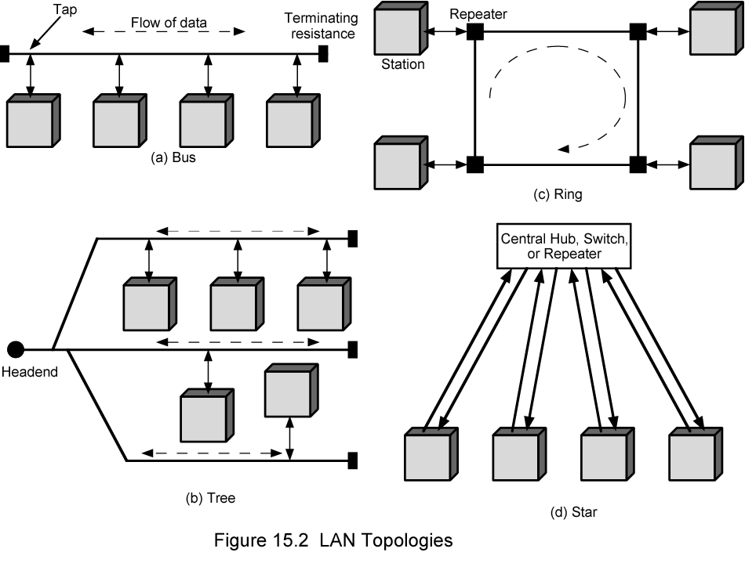
LAN Topologies

Slide 6
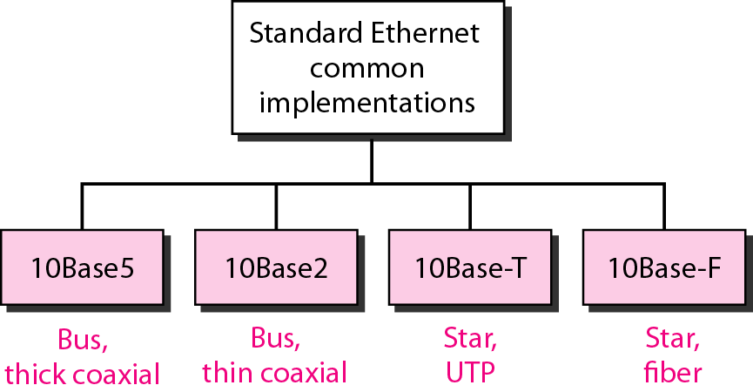
Categories of Standard Ethernet
Forouzan, B.A., (2010). Data Communications and Networking,4th Edition, Mc.Graw-Hill,Chapter 13

Slide 7
Bus and Tree
Multipoint medium
Transmission propagates throughout medium
Heard by all stations
Need to identify target station
Each station has unique address
Need to regulate transmission
To avoid collisions
To avoid hogging
Data in small blocks - frames

Slide 8
Star Topology
Each station connected directly to central node
Usually via two point to point links
Central node can broadcast
Physical star, logical bus
Only one station can transmit at a time
Central node can act as frame switch

Slide 9
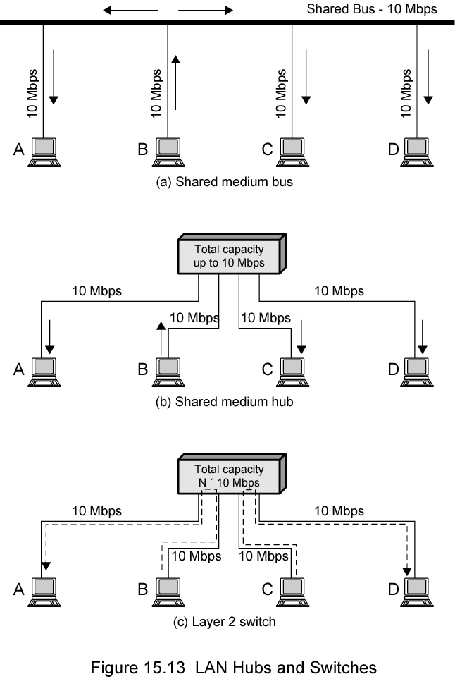
Shared Medium and Hub

Slide 10
Bus and Hub
Bus configuration
All stations share capacity of bus (e.g. 10Mbps)
Only one station transmitting at a time
Hub uses star wiring to attach stations to hub
Transmission from any station received by hub and retransmitted on all outgoing lines
Only one station can transmit at a time
Total capacity of LAN is 10 Mbps

Slide 11
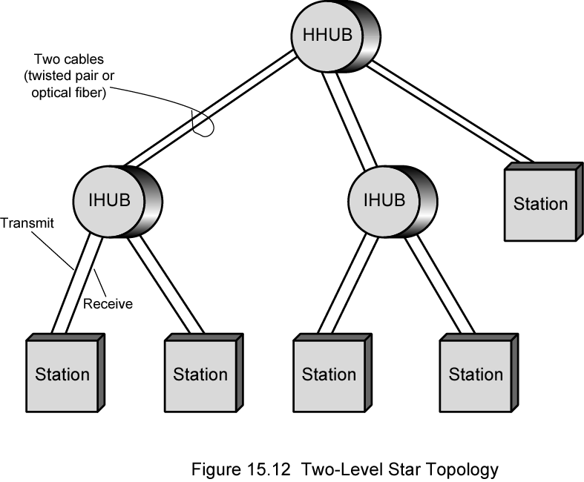
Two Level Star Topology

Slide 12
Hub and Layer 2 Switch

Slide 13
Layer 2 Switch Benefits
No change to attached devices to convert bus LAN or hub LAN to switched LAN
For Ethernet LAN, each device uses Ethernet MAC protocol
Device has dedicated capacity equal to original LAN
Layer 2 switch scales easily
Additional devices attached to switch by increasing capacity of layer 2

Slide 14
Protocol Architecture
Lower layers of OSI model
IEEE 802 reference model
Physical - UTP
Logical link control (LLC)
Media access control (MAC)

Slide 15
LAN Standards
Created by the IEEE (Institute of Electrical and Electronics Engineers)
IEEE is a professional organization
802 LAN MAN Standards Committee
802.3 Working Group (Ethernet)
Other working groups for other technologies
Working groups create standards
Follow the OSI architecture

Slide 16
Network Interface Card
NIC (Network Interface Card)
Connect your computer with network
Provide MAC addresses to each connection
Implement CSMA/CD algorithm Provides ports for network connection.
When selecting a network card, consider:
Type of network (Ethernet)
Type of media (Twisted-pair, Fiber-optic)
Type of system bus (PCI, ISA)

Slide 17
NIC Functions
Logical link control (LLC):
Communicates with upper layers in the computer
Naming:
Provides a unique MAC address identifier
Framing:
Part of the encapsulation process, packaging the bits for transport.

Slide 18
NIC Functions
Media Access Control (MAC):
Provides structured access to shared access media
Signaling:
Creates signals and interface with the media

